Slide 1



Machine Learning in Python
&
Muhammad Rizky Munggaran
Alvin prayuda

Slide 2
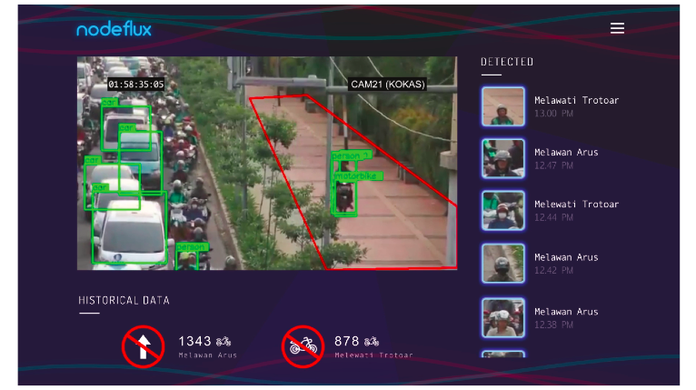
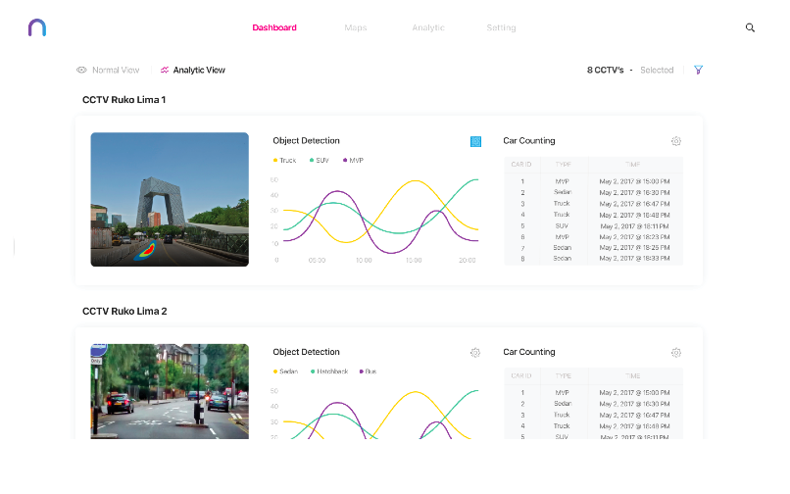

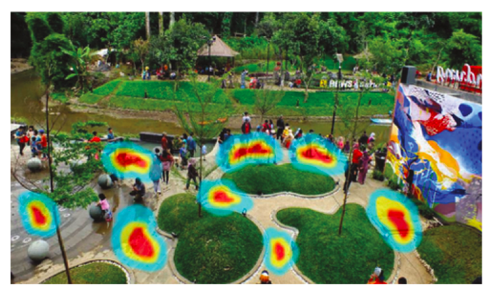
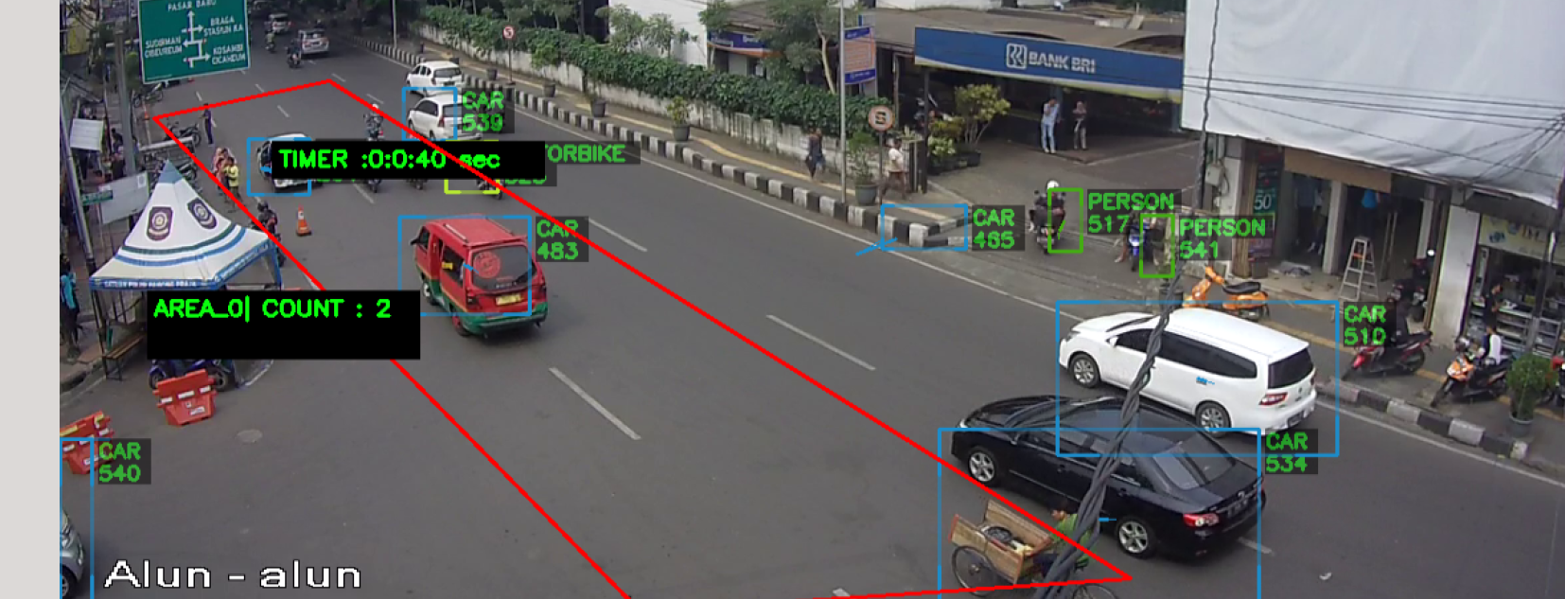
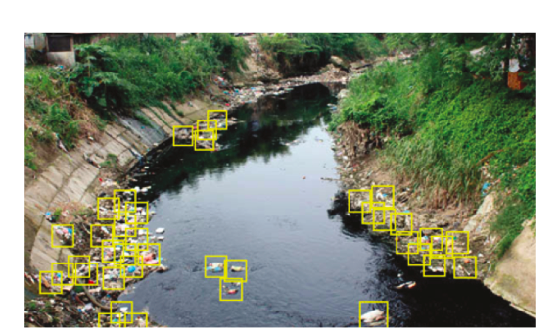
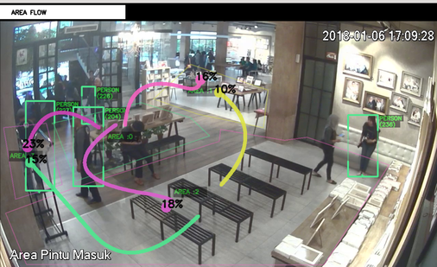
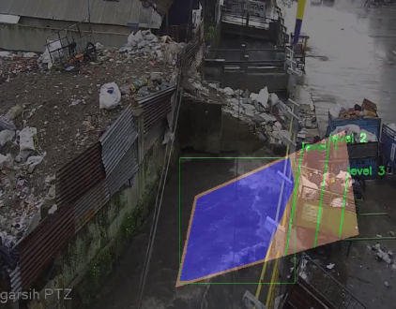
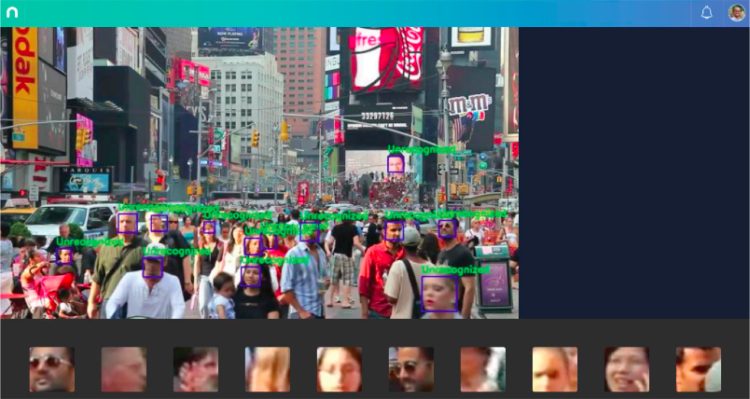
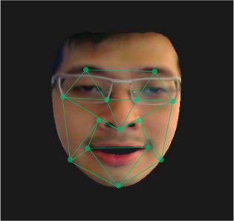
Product Overview
Nodeflux provide computer vision with deep learning to solve many challenging problems by extending vision using Artificial Intelligence.
Nodeflux’s products and services cover wide range of sector including but not limited to smart city, defense and security, traffic management, toll management, store analytic (wholesale and retail), asset and facilities management, advertising, and transportation.

Slide 3

Apply the fundamental concepts of machine learning from an available dataset using python.
Understand the process of :
Identifying the problem and load data Sources
Exploratory Data Analysis
Pre-Processing the Data
Build model
Improving the best models.
OBJECTIVE

Slide 4
Introduction Machine Learning (15-20 minutes)
Study case 1 : Classification problem (20 -25 minutes)
Study case 2 : Regression problem (20 -25 minutes)
Study case 3 : Real case (20-25 minutes)
This workshop is divided into three sections

Slide 5
Download and Install Anaconda 2
Checking the library installed
We assumes Python version 2.7 or 3.5.
There are 5 key libraries that you will need to install. Below is a list of the Python SciPy libraries required for this tutorial:
scipy
numpy
matplotlib
pandas
sklearn
Dependency
Python Environment
Note : make sure your Python environment was installed successfully

Slide 6
A
Introduction
Machine Learning
What is Machine Learning?
Why We Use Machine Learning?
How Machine Learning Works?
How do We Decide Which Machine Learning Algorithm to Use?

Slide 7
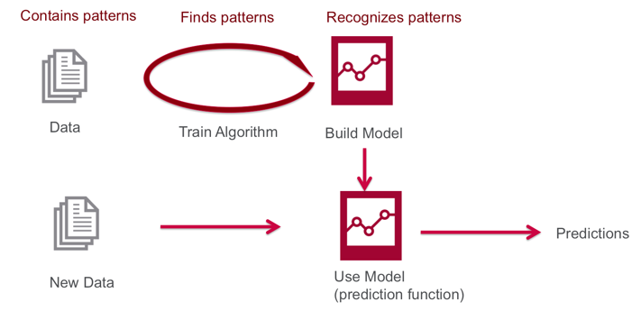
What is
Machine Learning?
Machine Learning is a field in Data Science, where machines can “learn” themselves, without being explicitly programmed by humans
Image reference : https://mapr.com/blog/demystifying-ai-ml-dl/

Slide 8
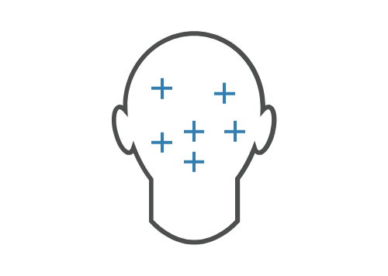

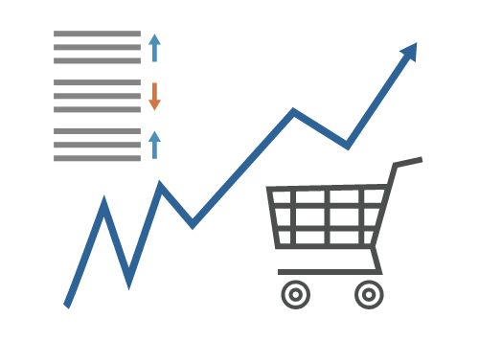
Why We Use Machine Learning?
Consider using machine learning when you have a complex task or problem involving a large amount of data and lots of variables, but no existing formula or equation.
Hand-written rules and equations are too complex as in face recognition and speech recognition.
The rules of a task are constantly changing as in fraud detection from transaction records.
The nature of the data keeps changing, and the program needs to adapt—as in automated trading, energy demand forecasting, and predicting shopping trends.

Slide 9


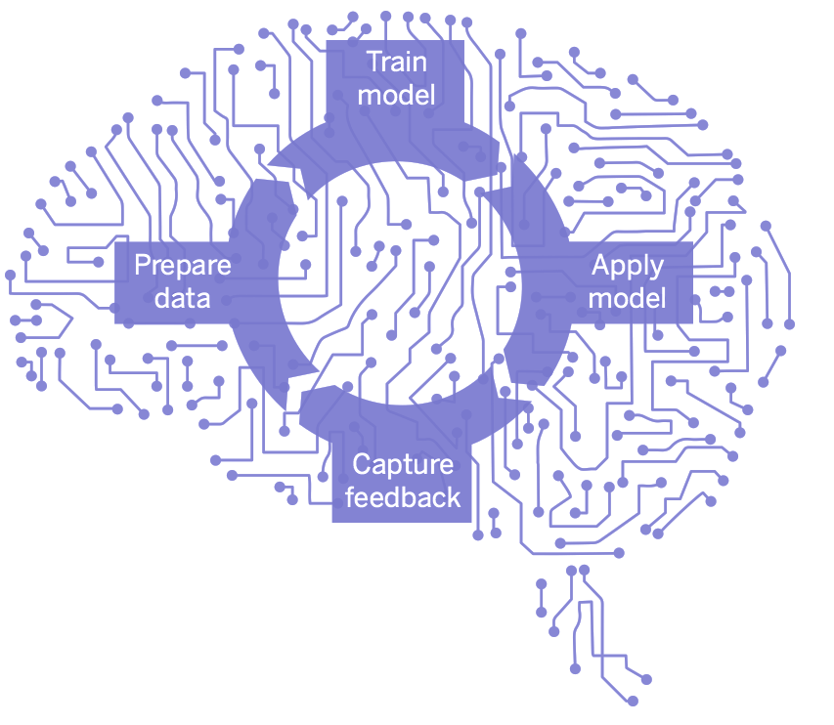




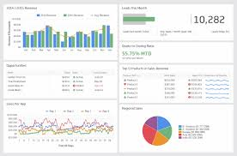
How Machine Learning Works??
Input Data source
Build Model
Predictive and visualization
Machine learning Work-flow breakdown
1. Identifying the problem
2. Data Explorations
3. Data Pre-Processing
4. Model Development
5. Model Improvement

Slide 10
Type of Machine Learning
Machine learning may be broken down into two types: supervised, unsupervised, and in between those two
MACHINE LEARNING
SUPERVISED
UNSUPERVISED
There are has labels associated with data points, Machine learning algorithms that make predictions on given set of samples. Supervised machine learning algorithm searches for patterns within the value labels assigned to data points.
There are no labels associated with data points. These machine learning algorithms organize the data into a group of clusters to describe its structure and make complex data look simple and organized for analysis

Slide 11
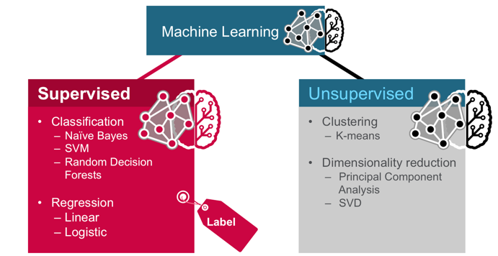
Technique of
Machine
Learning
Classification:
Based on training data having observations with
known categories.
Example :
fraud detection (fraud, not fraud)
credit card application (good credit, bad credit)
email spam detection (spam, not spam)
Regression:
Predicting a value from a continuous data set.
Example :
Predicting the price of a house
Age prediction
Clustering :
an algorithm classifies inputs into categories by
analyzing similarities between input examples.
Example :
grouping similar customers
Text categorization
Dimensionality Reduction :
In machine learning, “dimensionality” simply refers to
The number of features (i.e. input variables) in your
dataset.
Example :
Noise reducing

Slide 12
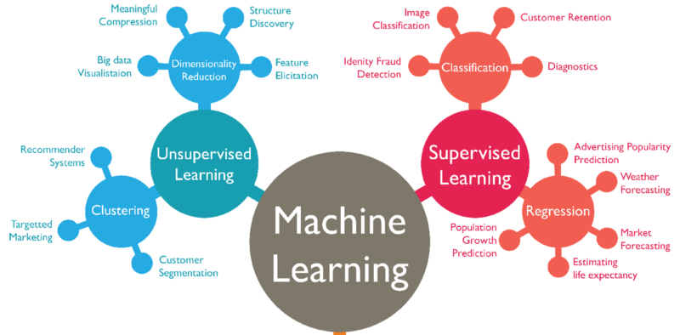
Example Case: Based on Technique
image reference: https://medium.com/marketing-and-entrepreneurship/10-companies-using-machine-learning-in-cool-ways-887c25f913c3

Slide 13
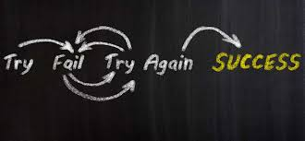
How do We Decide Which Machine
Learning Algorithm to Use ?
There is no best method or one size fits all. Finding the right algorithm is partly just trial and error. But, algorithm selection also depends on the size and type of data you’re working with, the insights you want to get from the data, and how those insights will be used.
Choosing the right algorithm can seem overwhelming—there are dozens of supervised and unsupervised machine learning algorithms, and each takes a different approach to learning.

Slide 14

image reference : http://scikit-learn.org/stable/tutorial/machine_learning_map/index.html

Slide 15
B
Study case 1 : Classification Problem
Problem description
Using Predictive Analysis To Predict Diagnosis of a Breast Tumor
* Please,Open jupyter notebook

Slide 16
Flow diagram
Model Improvement
Simple way
1. Identifying the problem
2. Data Explorations
3. Data Pre-Processing
4. Model Development
Checking the Accuracy

Slide 17
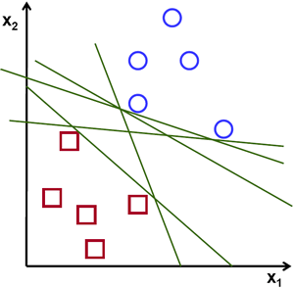
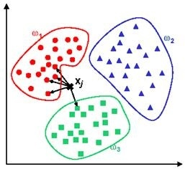
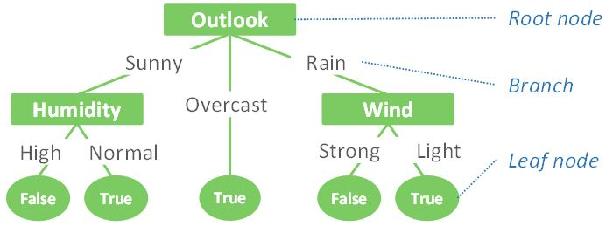
Classification Algorithm(1)
SVM
SVM is a discriminative classifier formally defined by a separating hyperplane, the algorithm outputs an optimal hyperplane which categorizes new examples.
Goal : find the line passing as far as possible from all points.
KNN
kNN is a nonparametric method for classifying objects based on the closest training examples in the feature space.
Goal : an object is classified by a majority vote of its neighbors, with the object being assigned to the class most common among its k nearest neighbors
DECISION TREE
the model is defined by a series of questions that lead to a class label or a value when applied to any observation.
Goal : To find solutions a decision tree makes sequential, hierarchical decision about the outcomes variable based on the predictor data.

Slide 18
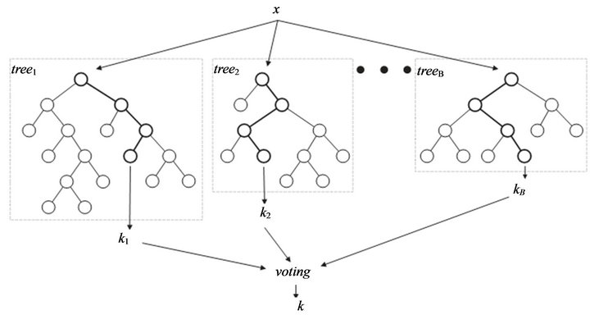
Classification Algorithm(2)
RANDOM FOREST
The random forest (RF) algorithms form a family of classification methods that rely on the combination of several decision trees.
Goal : to find solutions from multiple decision tree into a single ensemble (forest) and average predictions from individual trees.
NAIVE BAYES
Naive Bayes methods are a set of supervised learning algorithms based on applying Bayes’ theorem with the “naive” assumption of independence between every pair of features.
Goal : to find solution with calculate the posterior probability for each class. The class with the highest posterior probability is the outcome of prediction.

Slide 19
Feature Reduction
Principal Component Analysis
Principal component analysis (PCA) is a statistical procedure that uses an orthogonal transformation to convert a set of observations of possibly correlated variables into a set of values of linearly uncorrelated variables called principal components
Matrix data inputs
New feature with independent correlation
coloms
Rows
PC 1
PC 2
PC 3
PC 4

Slide 20
C
Study case 2 : Regression Problem
Problem description
Predicting Boston Housing Price
* Please,Open jupyter notebook

Slide 21
Thank You..
Thanks you..

